Slide 1
Python: Operators Part 2
Lesson 4

Slide 2
Review Questions

Slide 3
What will be displayed by this program?
phrase = “Hello There!”
print(len(phrase))
Hello There!
12
11
14
Correct Answer: B

Slide 4
What will be displayed by this program?
num1 = 4
num2 = 8
num1 = 6
num3 = num1 + num2
print(num3 * 2)
24
20
28
None of the above
Correct Answer: C

Slide 5
What will be displayed by this program?
num1 = 4 num2 = 3 num3 = 13 % num1 num2 = 13 // num1 print(num2 * num3)
3
4
9
12
Correct Answer: A

Slide 6
What will be displayed by this program?
phrase = “Hello”
word = “Hi”
print(phrase[0] != word[0])
Hello Hi
True
False
H H
Correct Answer: C

Slide 7
More Operators

Slide 8
What are operators?
Last week, we covered these operators:
Arithmetic
Comparison
Today, we will be going over the remaining 3 types of operators:
Assignment
Logical
Bitwise

Slide 9
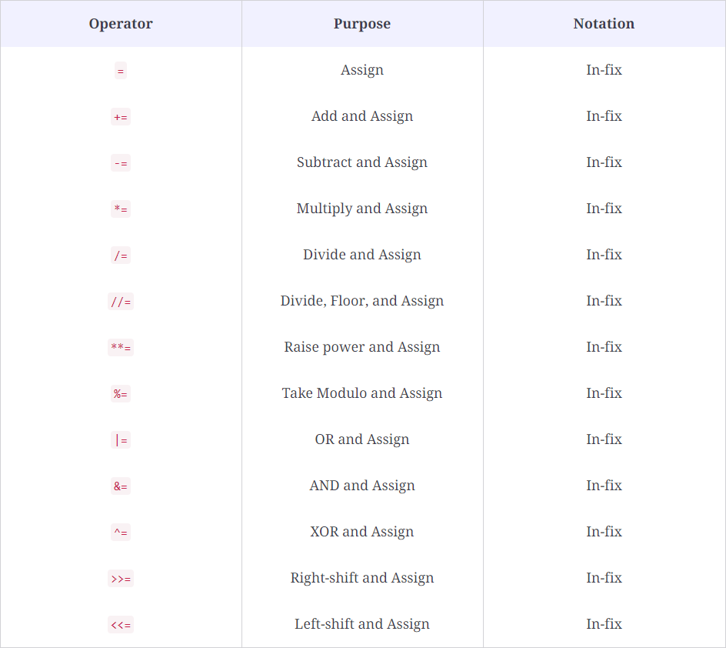
Assignment Operators
This is a category of operators which is used to assign values to a variable. The = operator we’ve used until now is an assignment operator, but not the only one.
Here is a chart of all the assignment operators in python.

Slide 10
Assignment Operators (cont.)
Other Operator
= Sign
These operators take the format of
Ex: += is the plus operator and =
This essentially updates a value while also performing an operation on it.
The code value = value + 1 adds 1 to the previous value of the variable.
This is essentially the same as value += 1, which updates the variable while adding one as well.
The other operators work the same way.

Slide 11
Assignment Operators Practice
What will be displayed by this program?
num1 = 5 num1 += 2 print(num1)
2
7
5
3
Correct Answer: B

Slide 12
Assignment Operators Practice
What will be displayed by this program?
num1 = 5 num2 = -3 num2 += num1 print(num2)
2
-2
5
-3
Correct Answer: A

Slide 13
Assignment Operators Practice
What will be displayed by this program?
num1 = 5 num1 %= 2 print(num1)
2
1
5
10
Correct Answer: B

Slide 14
Assignment Operators Practice
What will be displayed by this program?
num1 = 3 num2 = 7 num3 = -1 num2 //= num1 print(num3 + num2)
2
-2
1
7
Correct Answer: C

Slide 15
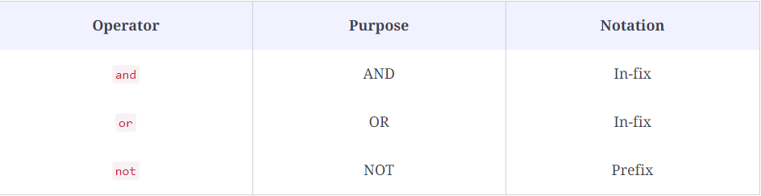
Logical Operators
Logical operators are used to manipulate the logic of Boolean expressions.
The 3 main logical operators are and, or, and not

Slide 16
Logical Operators (cont.)
AND: The and operation is used with two boolean values or expressions. It only returns true if both of the values are true. For example,
True and False would return False, while True and True would return True.
OR: The or operation is used similarly to the and operation. However, this returns true if even one of the boolean values are true. For example,
True and False would return True, while True and True would also return True.
NOT: The not operation simply reverses the value of the boolean statement. For example,
not True would return False, and vice versa.

Slide 17
Logical Operator Practice
What will be displayed by this program?
value = True print(value and False)
True or False

Slide 18
Logical Operator Practice
What will be displayed by this program?
val1 = True val2 = False print(val1 or val2)
True or False

Slide 19
Logical Operator Practice
What will be displayed by this program?
val1 = True val2 = True print(not(val1 and val2))
True or False

Slide 20
Logical Operator Practice
What will be displayed by this program?
val1 = True val2 = False print((True or val2) and (False or val2))
True or False

Slide 21
Kahoot Quiz
On Python Operators

Slide 22
Bit Value
All the code we see around us in today’s world is actually made up of bits. Combinations of 1s and 0s form the foundation of programming.
In bit terms, the value of True is 1, while False corresponds to 0.
The Python compiler can automatically convert booleans into bit form when needed. For example,
print(10 * True) would return 10, as True corresponds to 1 and 10 * 1 = 10. The same goes with False.

Slide 23
Bit Value Practice
What will be displayed by this program?
val1 = True val2 = False print(val1 + 2)
3
True2
2
It will give an error.
Correct Answer: A

Slide 24
Binary
In normal numbers, we have 10 digits, from 0 to 9. Binary is another number system, but it uses only 2 digits - 0 and 1.
Each place value in normal numbers is an exponent of 10. For example, the number 1,435 is 1000 + 400 + 30 + 5. You can think of that as having 5 ones, 3 tens, 4 hundreds, and 1 thousand.
The same is for binary, except instead of going up by x10 each time, it goes up by x2. For example, in binary, the number 1101 can be seen as having 1 one, 0 twos, 1 four, and 1 eight. Adding these up gives 13, meaning the binary number 1101 is equal to 13.
Notes:
Review binary before doing bitwise operators

Slide 25
Binary Practice
Convert the binary number 11010 into decimal (the regular number system).
ANSWER: 26
Convert the binary number 010111 into decimal (the regular number system).
ANSWER: 23
Convert the decimal number 14 into binary.
ANSWER: 1110
Convert the decimal number 27 into binary.
ANSWER: 11011

Slide 26
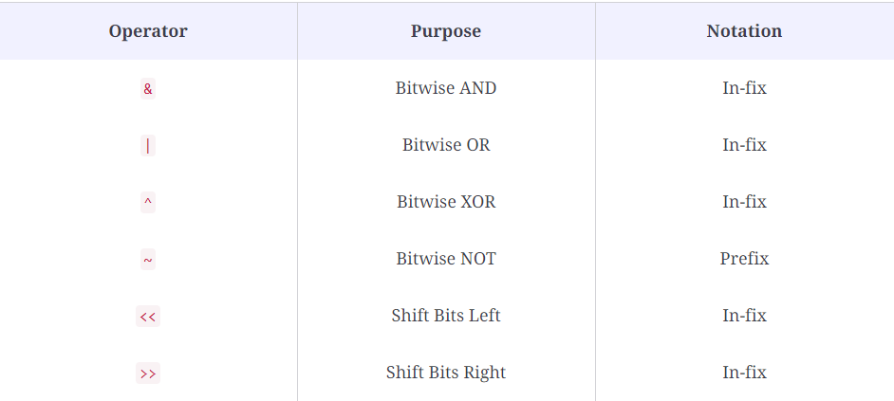
Bitwise Operators
Bitwise operators are the most difficult of the operators to learn, and it has to do with binary.
In programming, all data is actually made up of 0s and 1s known as bits. Bitwise operators allow us to perform bit-related operations on values. The bitwise operators are shown above.
Now, we will see how they are used and why it works that way.

Slide 27
Bitwise AND
Here is an example of how one might use the bitwise AND operator:
num1 = 10 num2 = 20 print(num1 & num2)
The output of this program ends up being 0.
01010
10100
This is because it converts these numbers to binary first: 10 in binary is 01010, and 20 in binary is 10100.

Slide 28
Bitwise AND
Here is an example of how one might use the bitwise AND operator:
num1 = 10 num2 = 20 print(num1 & num2)
01010
10100
It starts by comparing the first binary digits of both numbers. True and False correspond to 1 and 0 in binary, respectively. Since the first digits are 0 and 1, that is the same as True and False, which is just False. You can think of it as multiplication with the 2 digits: 0 x 1 = 0, 0 x 0 = 0, and 1 x 1 = 1.
Then, you repeat this process with all the digits to get 00000 in binary, or the number 0.
Notes:
This is a complex concept, so make sure they know to ask questions if they need to.

Slide 29
Bitwise OR
The bitwise OR works similarly to the bitwise AND.
However, instead of doing an and operation, it does an or operation.
num1 = 10 01010 num2 = 20 10100 print(num1 | num2)
If you take the output of the first digit of num1 or the first digit of num2, you get 1, as 0 or 1 = 1. Repeat this for all digits and you get the binary number 11110, or 30. You can think of this as addition: 0 + 0 = 0, 1 + 0 = 1, and 1 + 1 = 1 (binary digits cannot go above 1).
Notes:
Make sure to make the analogies clear.

Slide 30
Bitwise XOR
The XOR operator, or Exclusive OR, only returns True if both of the inputs are different.
For example:
True XOR False returns True, False XOR True returns True but False XOR False returns False, and True XOR True returns False.
Similarly to the bitwise OR and AND, it compares the binary digits using XOR.
For example, 13 (1101) XOR 14 (1110) would return 12 (1100).
Notes:
If they want an explanation for how this adds up, go through it.

Slide 31
Bitwise Shift
There are 2 shift operations - shift left and shift right. They just shift the ones to the left or right the specified amount of times. Take the operation 0110 << 2 for example:
0110 is the same as 000110, the zeros are just placeholders.
000110 (original) → 001100 → 011000 (2 shifts to the left)
This is how a right shift by 2 would look:
0110 (original) → 0011 → 0001 (2 shifts to the right)
Note that it doesn’t create placeholders when going to the right--instead it just goes away.

Slide 32
Bitwise Operator Symbols
Make sure you remember the symbols for the bitwise operators, because they are different from the other ones. Also, remember that the output of these programs is not in binary, it is in decimal (normal numbers).
Note: we skipped over the bitwise NOT operator because it is very complex.

Slide 33
Bitwise Operator Practice
What will this program display?
num1 = 10 num2 = 15 print(num1 & num2)
0
10
15
5
Remember that this is an AND operation.
Correct Answer: B
1010
1111

Slide 34
Bitwise Operator Practice
What will this program display?
num1 = 17 num2 = 27 print(num1 | num2)
17
0
27
12
Remember that this is an OR operation.
Correct Answer: C
10001
11011

Slide 35
Bitwise Operator Practice
What will this program display?
num1 = 9 num2 = 12 print(num1 ^ num2)
5
12
13
10
Remember that this is a XOR operation.
Correct Answer: A
1001
1100

Slide 36
Bitwise Operator Practice
What will this program display?
num1 = 13 print(num1 << 2)
0
10
15
5
Remember that this is a shift operation.
Correct Answer: A
001101

